Slide 1
QR CODE GENERATOR

Slide 2

GROUP MEMBERS
Vijaya Vyshnavi
AP21110010119
Neeli Meghana
AP21110010127

Slide 3
Abstract
QR codes are machine readable two dimensional pixelated barcodes which can be used to store a variety of information. QR in QR code stands for Quick Response. QR code was invented by a Japanese engineer Masahiro Hara from automobile manufacturer Denso Wave in the year 1994 to track the movement of car parts.
QR codes often contain data for a locator, identifier, or tracker that points to a website or application. QR codes use four standardized encoding modes (numeric, alphanumeric, byte/binary, and kanji) to store data efficiently; extensions may also be used.

Slide 4
Objective
By using QR CODE GENERATOR we can generate qr code for any file or website.
So let’s say you scan a QR code which contains a web address (URL). When you scan it with your phone, you will be directed to the website that’s embedded inside the QR code.People are even starting to use QR codes on their business cards to send people to their LinkedIn profiles or Twitter. The uses are endless.

Slide 5
Algorithm
Step 1: Importing Qrcode and Tkinter libraries.
Step 2: Making the primary window.
Step 3: Create a function that takes any text or URL as an input
and generates a QR code.
Step 4: Create a User Interface for the application to Generate
QR Code in Python.

Slide 6
Module
The Python import statement lets you import a module into your code. A module is a file that contains functions and values that you can reference from your program. The import statement syntax is: import modulename.
Here we used the module – import Qrcode and Tkinter library

Slide 7
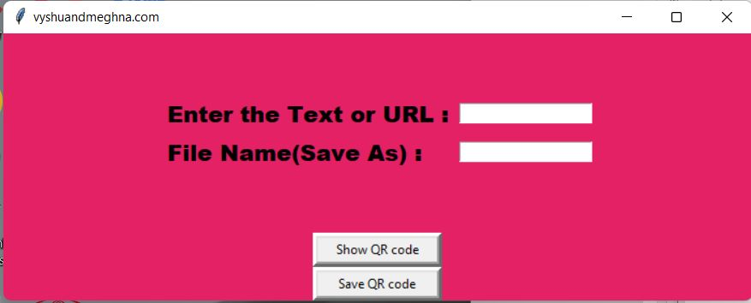
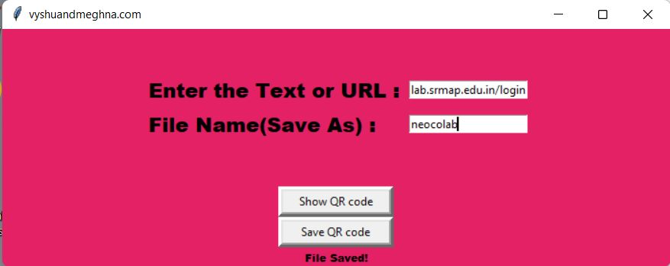
Output:

Slide 8
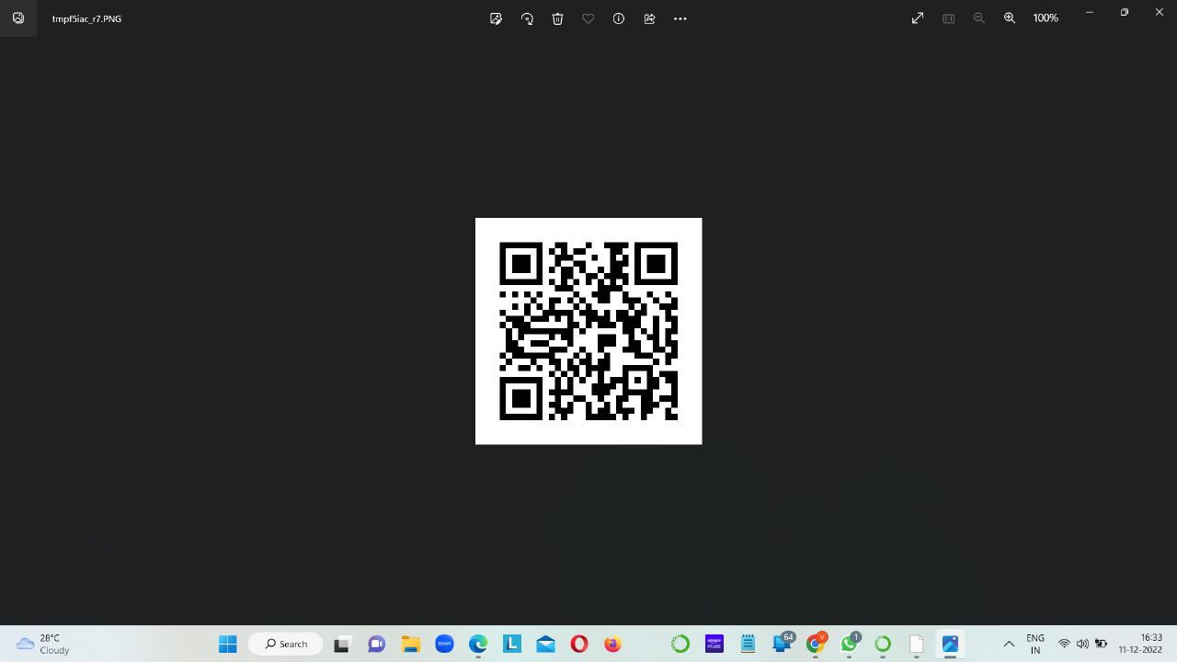

Slide 9
THANK YOU

